Slide 1
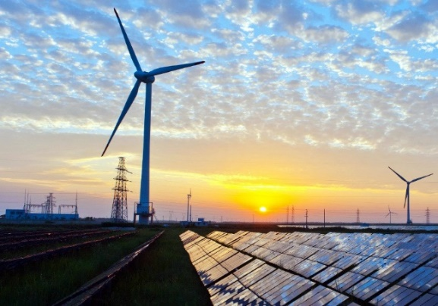
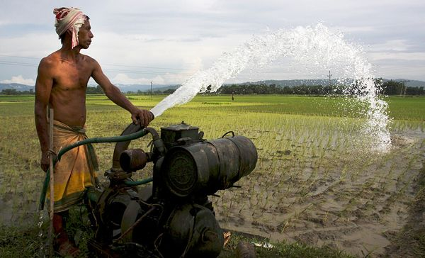
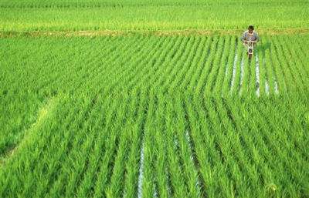
Introduction to the Nexus Solutions Tools and its real-World case studies
Adriano Vinca
International Institute for Applied Systems Analysis
Workshop on the introduction of Integrated Assessment Modelling and understanding the multi-sectoral policy insights
September 22 -23, 2022
Centre for Water Informatics & Technology, LUMS, Lahore

Slide 2
Overview
Introduction to Nexus concept and models
NEST:
What is it? Methods, use, data
How to access and use it
New MESSAGEix-Nexus module, the new NEST
Our way forward

Slide 3
Climate-Land (food)-Energy-Water Nexus
C
L
I
M
A
T
E
+
2
°
C
C
O
2
a
n
d
G
H
G
e
m
i
s
s
i
o
n
s
WHEN IS CLEW NEXUS RELEVANT?
CURRENT GAPS AND LIMITATIONS
RECOMMENDATIONS TO FOSTER THE USE OF NEXUS TOOLS
P
r
e
c
i
p
i
t
a
t
i
o
n
,
E
v
a
p
o
r
a
t
i
o
n
C
O
2
T
R
A
D
E
-
W
a
O
F
F
t
e
r
s
t
o
r
a
g
e
:
E
n
e
r
g
y
,
f
•
e
o
o
d
l
e
c
t
r
i
c
i
t
•
a
g
y
r
i
c
u
l
t
u
r
e
a
n
d
w
a
t
e
•
w
a
r
t
e
r
d
e
m
a
n
d
f
o
r
c
i
t
i
e
I
s
r
r
i
g
a
t
i
o
n
,
C
O
f
2
a
r
m
i
n
g
P
o
w
e
r
p
l
a
n
t
s
B
i
o
f
u
e
l
C
O
T
R
A
D
E
2
-
L
O
F
F
a
n
d
u
s
e
•
f
:
o
r
e
s
t
•
a
g
s
r
i
c
u
l
t
i
r
e
/
f
a
r
•
b
m
i
o
f
u
e
l
s
I
n
d
u
s
t
r
•
s
y
o
l
a
r
e
n
e
r
g
y
G
r
o
u
n
d
w
a
t
e
r
p
u
m
p
i
n
g
E
l
e
c
t
r
i
c
i
t
y
F
o
s
s
i
l
f
u
e
l
s
F
o
o
d
B
i
o
-
e
n
e
r
g
y
Vinca et al., 2021 Frontiers in Environmental Science

Slide 4
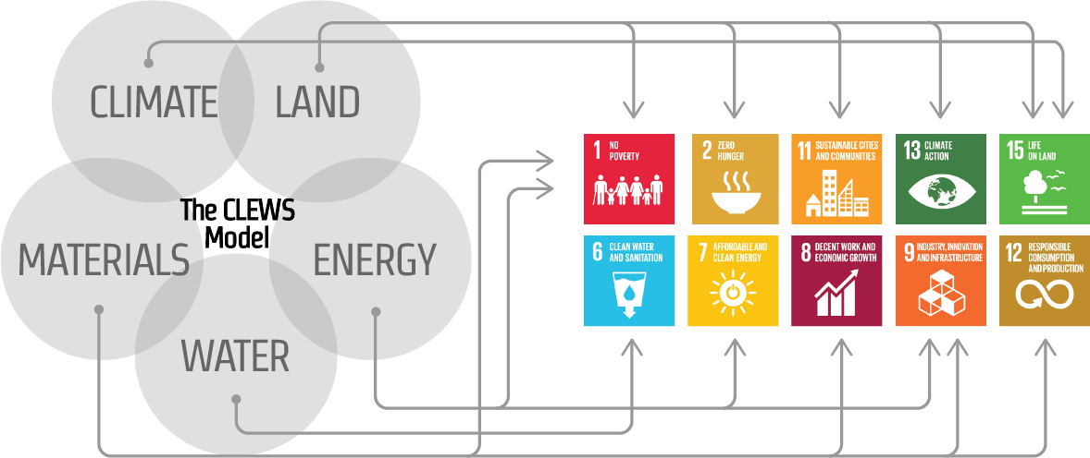
WEL nexus modelling and open-source
Recent boom of new models or interlinkages of existing models. Different scales, model configurations (soft link-integrated)
Regional assessment, e.g. CLEWS
Global analysis, e.g. MESSAGE-GLOBIOM, GAMS
Clear advantages of modelling and capturing nexus interactions among sectors. Higher uncertainty, difficult to assess: not enough studies to allow comparison, or very different models, not always well documented
Open-source: code, software, data, analysis results

Slide 5
Sectoral gap – Theme gap
Simple macro-economic assumptions.
Lack of socioeconomic aspects: inequality, individual/corporate choices, governance
Stakeholder engagement → empirical models, ABMs
In average good balance in sectoral components
Vinca et al., 2021 Frontiers in Environmental Science

Slide 6



NExus Solutions Tools (NEST)
Geospatial
Database
Results Database
The NExus Solutions Tool (NEST)
River
networks
Energy system pathways
CWatM – Water Resource Assessment
Distributed Hydrological Model
Calibration
Water system pathways
Climate scenarios
Soil Moisture
Potential
Runoff / Recharge
River Routing
Human dev. scenarios
Land-use pathways
Scenario Generator (SSP-RCP scenarios)
Econometric models and scaling tools
Resource potentials
Investment pathways
Water
System
Costs and policies
Land
System
Energy
System
Ecosystem indicators
MESSAGEix – Resource Planning
Linear Programming Optimization Model
Existing assets
Air emissions

Slide 7
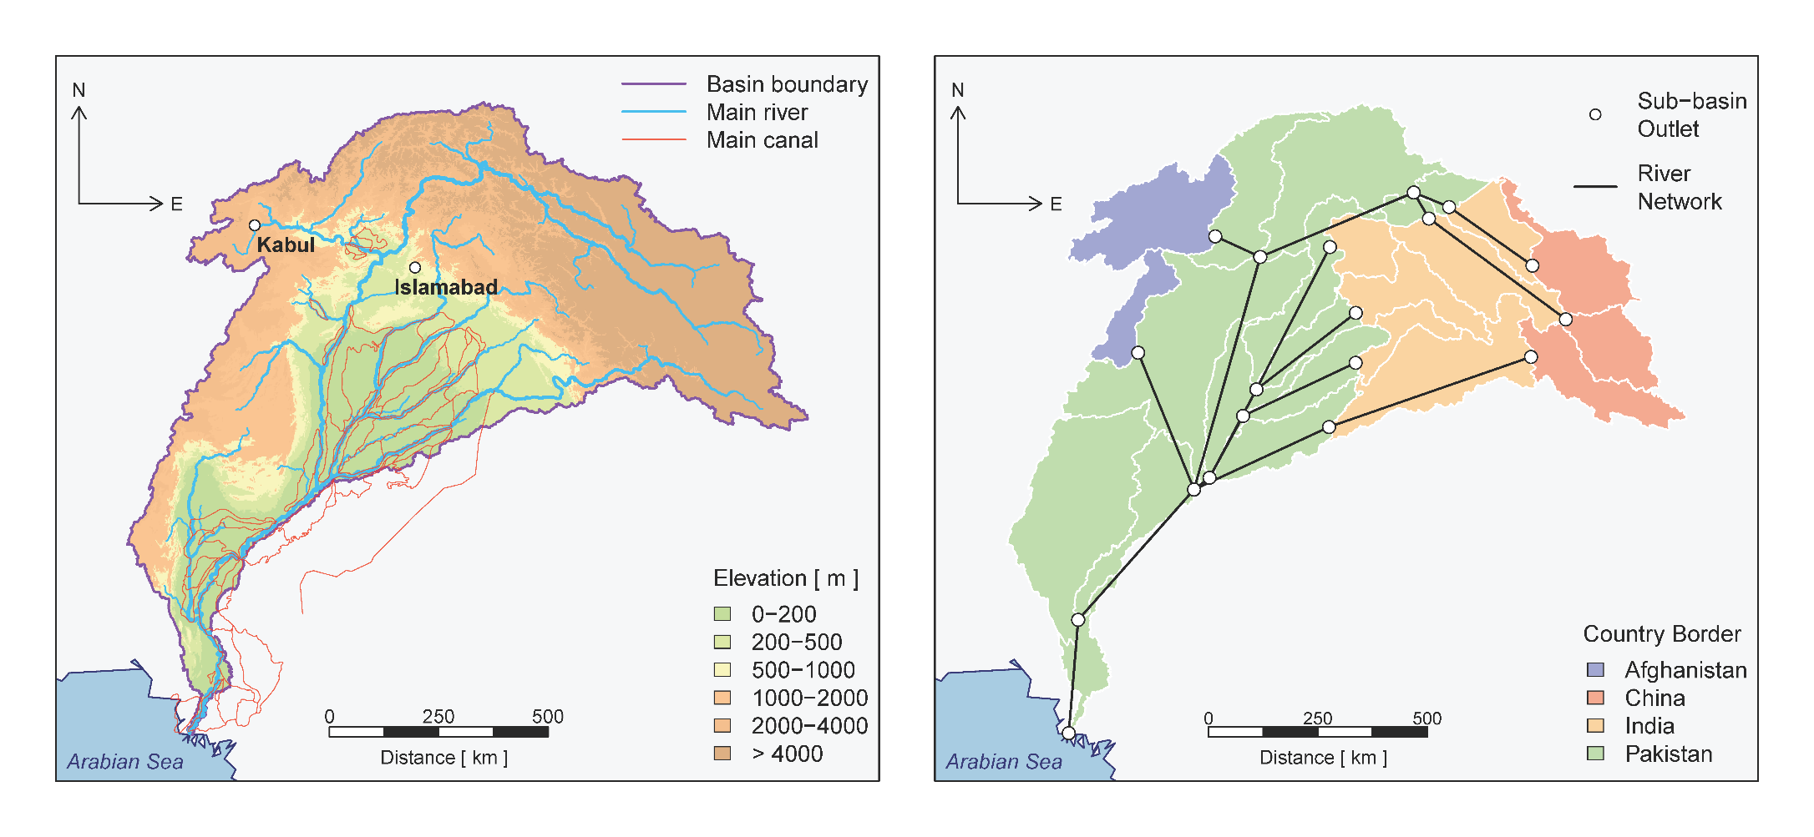
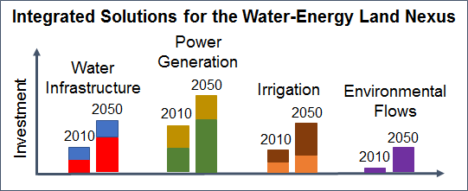
The core model
NExus Solutions Tools (NEST)
Distributed Hydrology
Community Water Model (CWatM)
(Burek et al., 2018)
Infrastructure Planning
MESSAGEix
(Huppmann et al., 2018)
CWaTM
MESSAGE
Upscaling
Potential ET Effective precipitations
Runoff availability
Water
Techs
Land
Techs
Energy
Techs
Downscaling
Water and
land-use
Minimize total system cost

Slide 8
Water system
W
a
t
er
di
s
t
r
i
b
uti
o
n
W
a
t
er
de
m
an
d
R
e
tu
r
n
f
l
ows
*
P
u
mpi
n
g
U
r
b
an
*
(
a
nd
U
r
b
a
E
n
l
ect
r
ic
i
t
y
i
n
dus
t
ri
a
l
)
r
e
cha
r
ge
f
r
o
m
D
e
sal
i
na
t
io
n
R
u
ral
*
R
u
ra
r
l
i
v
e
r
s
,
c
ana
l
s
a
n
d c
r
op
fie
l
d
s
W
a
t
er
de
v
iat
i
o
n
E
n
e
r
g
y
s
e
c
t
o
r
G
r
oun
d
wa
t
er
+
W
a
t
er
di
s
t
r
i
b
u
-
L
a
nd
s
ec
t
o
r
t
i
S
o
n
e
awa
t
e
r
w
a
s
t
e
w
a
t
e
r
t
r
eat
m
en
t
a
n
d
r
e
c
y
c
l
I
e
n
t
e
r
n
al
s
u
r
fa
c
e
w
a
t
er
+
S
u
r
fa
c
e
w
a
t
e
r
E
l
ect
r
ic
i
t
y
E
n
vi
r
o
nm
e
nta
l
fl
o
w
S
s
t
ora
g
e
W
a
t
er
r
e
t
u
r
n
f
l
ows
f
r
o
m
e
n
e
r
g
y
s
e
c
t
o
r
H
y
d
r
o
e
le
c
tri
c
p
o
t
en
t
ia
R
l
i
v
er
ne
t
w
or
k
n
o
de
u
p
n
o
de
d
ow
n
n
o
d
e
*
e
x
o
ge
n
ou
s
+
lim
i
nt
s
a
r
e
im
p
os
e
d
b
a
se
d
on
in
f
o
r
m
a
tio
n
f
r
om
h
y
d
r
olo
c
ia
l
mo
d
e
l

Slide 9
Energy system
P
o
w
er
pl
a
nt
s
P
o
w
er
tr
a
nsm
i
ssi
o
n
E
l
ect
r
ic
i
ty
d
ema
n
d
F
o
ssi
l
(
n
atu
r
W
al
a
t
er
fo
r
g
a
s,
c
o
a
l
, o
i
c
l,
o
oli
n
g
c
c
s
)
U
r
b
an
*
(
a
T
nd
r
ans
m
is
s
ion
H
V
i
n
dus
t
ri
a
l
(
)
t
o o
t
he
r
no
d
es
)
N
u
cle
a
r
D
i
st
r
i
bu
t
io
n
R
u
ral
*
(
i
n
t
e
r
na
l
)
B
i
o-f
u
el
^
(e
t
han
o
l
B
i
oma
s
o
s
&
r
so
l
id
bio
m
ass
)
c
o
-fi
r
in
g
W
a
t
er
se
c
t
o
R
r
u
ral
ge
n
era
t
io
R
n
e
tun
fl
o
w
s
D
i
ese
l
g
e
ner
a
t
o
r
L
a
nd
s
ec
t
o
S
o
lar
&
W
in
d
S
m
all
P
V
r
E
t
han
o
l
g
ene
r
a
t
o
r
H
y
d
r
o
e
le
c
tri
c
H
y
d
r
o
e
le
c
tri
c
B
i
o-f
u
el
^
(e
t
han
o
p
o
l
t
en
t
ia
l
o
r
so
l
id
bio
m
ass
)
C
O
a
nd
o
th
e
r e
m
iss
i
on
2
s
*
e
x
o
ge
n
ou
s
e
t
h
an
o
l,
t
e
c
h
n
ol
g
ie
s
n
o
t
r
e
p
r
e
s
en
t
ed
h
e
r
^
c
e
r
o
p
r
e
sid
u
es
c
an
be
t
ra
n
spo
r
t
e
d
as
sol
i
d
b
iom
a
ss
or
c
on
v
e
r
t
e
d
i
n

Slide 10
Land system
C
r
op
s
I
r
r
ig
a
t
e
d
C
r
op
p
r
o
d
uct
s
d
e
man
d
C
*
r
op
p
r
oduct
s
b
y
co
u
nt
r
E
y
l
ect
r
ic
i
ty
f
r
om
I
r
r
ig
a
ti
o
n s
y
s
t
e
m
s
g
r
id
o
r
l
oca
l
g
e
ner
a
t
o
r
s
F
l
oo
d
W
a
t
er
fo
r
S
r
ink
l
e
r
i
r
rig
a
ti
o
n
T
ota
l
land
L
a
nd
a
v
a
i
lab
i
lit
y
?
D
r
i
p
cons
t
raint
s
I
r
rig
a
ti
o
n
l
o
sse
s
R
a
inf
e
d
o
nl
y
C
H
4,
o
th
e
r
e
m
is
s
io
n
s
,
w
a
t
er
po
l
l
ut
a
nt
s
C
r
op
r
esidue
s
B
i
oma
s
W
s
a
t
er
fo
r
E
n
e
r
g
y
sec
t
o
t
r
r
ans
p
o
r
t
a
ti
o
b
n/
i
o-f
u
el
c
o
n
v
e
r
si
o
n
p
r
odu
c
ti
o
n
*
e
x
o
ge
n
ous
.
?
t
ot
a
l
a
v
ai
l
abl
e
a
r
ea
f
or
agr
i
cu
l
tu
r
e
b
a
s
ed
on
h
is
t
ori
c
al
dat
a

Slide 11
Potential applications of the model for policy analysis
Impacts of reduced resource availability and alternative allocation schemes
Influence of technology-specific penetration targets on multi-sector development
Quantification of investments required to meet future demands
Identification of feasible transformation pathways for achieving socio-environmental objectives
Effects of cooperative / non-cooperative strategies across countries

Slide 12
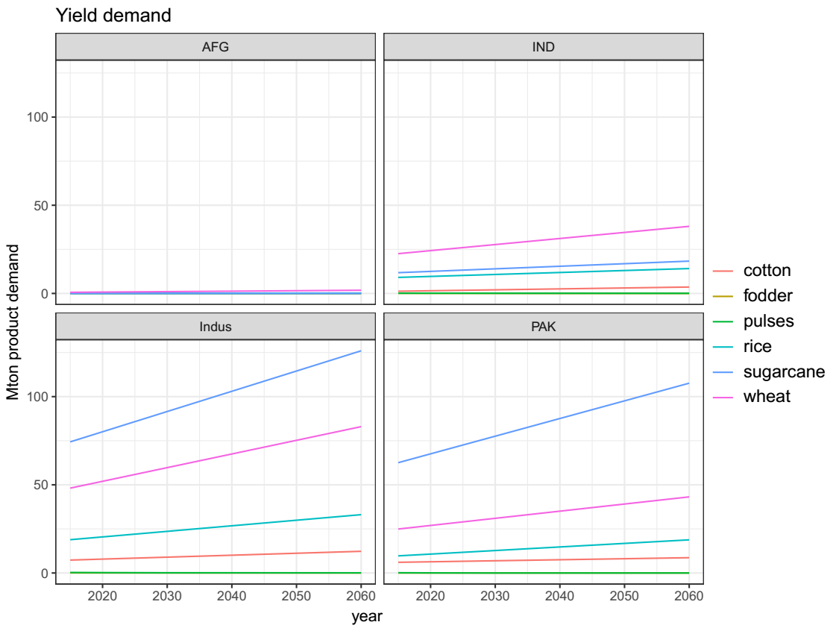
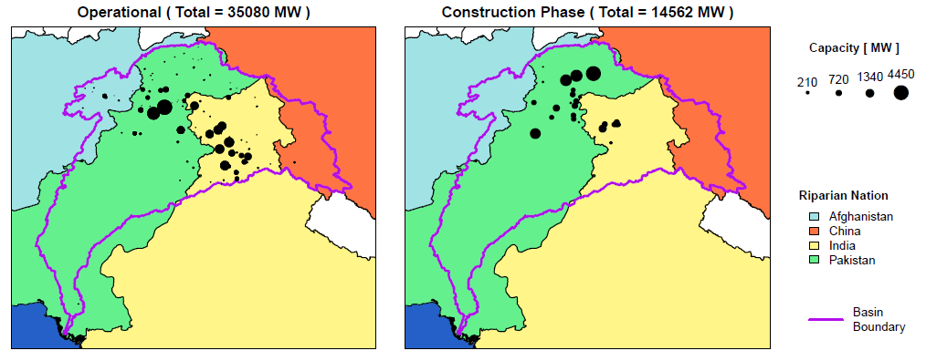
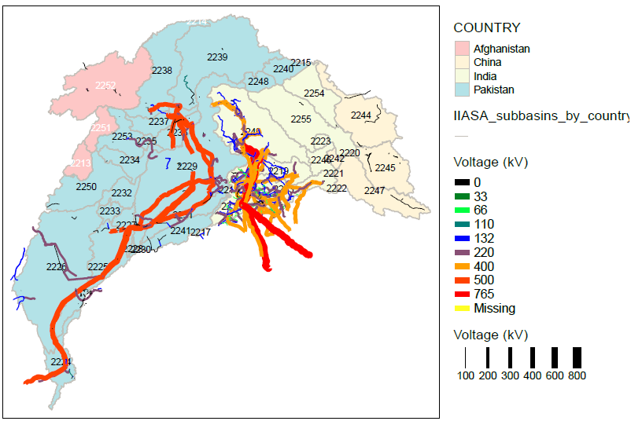
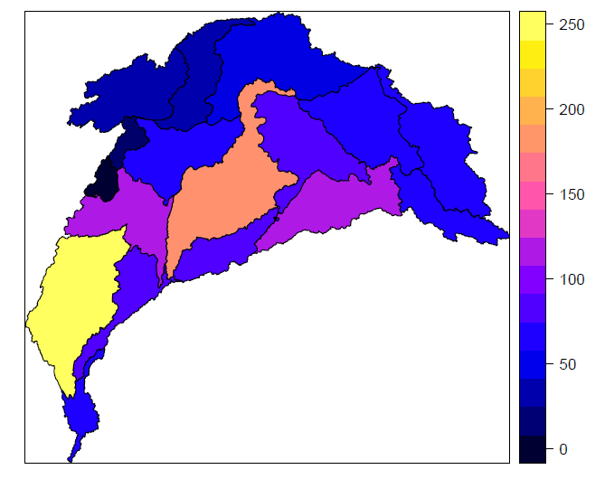
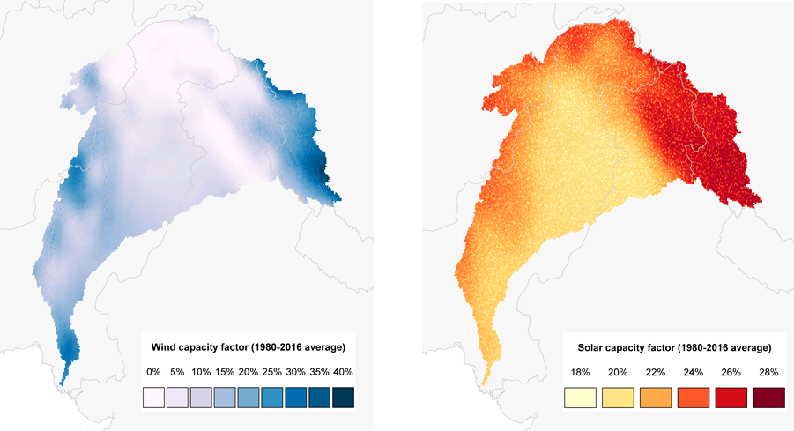
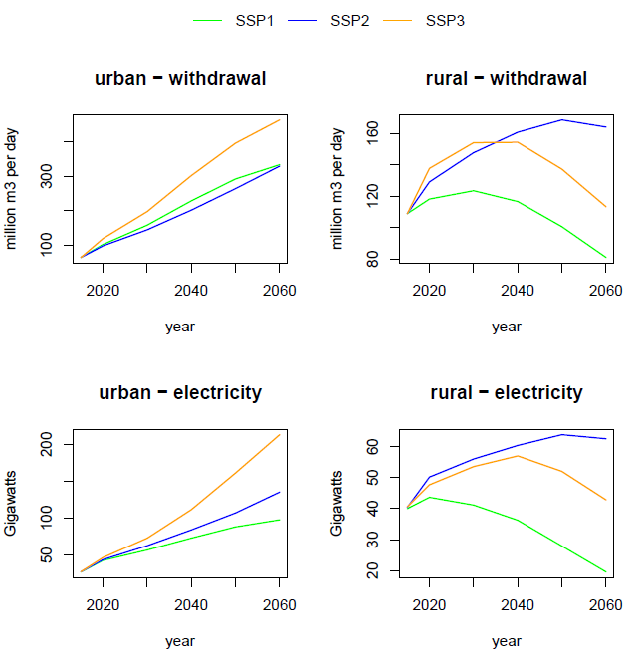
Input data
Mapping infrastructure, potentials and policies
Power generation and Reservoirs (existing and planned)
Transmission and road networks
Groundwater pumping capacity
Wind, PV and hydropower potentials
Assessment of demands
Land use and production maps
Indus water treaty allocations
Urban water transfers (e.g., Karachi)
Irrigation technologies local data
Installed Hydropower Capacity
Wind and PV average capacity factor (based on hourly data)
Installed Transmission Capacity
Groundwater Pumping in 2010 [ billion cubic meters per year ]
Urban and rural water withdrawal and electricity demand
Notes:
Before moving to results let me go through some data and stress again the fact that the stakeholder engagement was fundamental for obtaining some local data

Slide 13
Shaping scenarios
Business-as-usual (or Baseline) with calibrated population, water, energy and crop demand
Projections based on SSP2 database and RCP6.0 climate assumptions
> Research question: what are the costs and implications to achieve SDG in the region?
> Identify sectors, parameters, constraints that can be changed to model specific policies or changes that address the research question
 | BAU | SDG
Energy | NDC implementation | NDCs + GHG targets for carbon neutrality in 2050
Water treatment/ sanitation | Projection of current rates with GDP growth | Increased access: i.e Urban sanitation access 95%
Water efficiency | No measures | Limits water withdrawals for agriculture
Environmental flows | No policy | Satisfy minimum requirements at Indus Delta
Land | Projected trend of flood irrigation use | Diverse irrigation possibilities and crop shifts

Slide 14



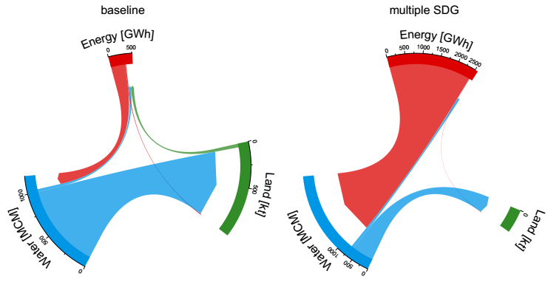
Model application
Comparing baseline with preliminary SDG 6 + 7 + 13 scenario
Average yearly costs for the entire basin (2020-2050)
Average yearly cross-sectoral energy, water and biomass flows
Low carbon tech and wastewater distribution and treatment.
Use of more efficient, but costly irrigation technologies. Higher land requirements
Less water used in agriculture
Much more energy required for pumping, treating, water infrastructure, power plants
Notes:
Mention that hydro potential is very high also in the baseline

Slide 15
Importance of integrated framework
Electricity production under different scenarios
More efficient solution
Cost effective
Take into account synergies

Slide 16
Sensitivity
baseline scenario, different SSPs, climate models and climate scenarios (RCP 2.6 and 6.0)
Cost
Internal runoff from CWATM same for all SSP
Groundwater extraction
Water use:
Most noticeable differences among models and scenarios, rather than SSPs

Slide 17

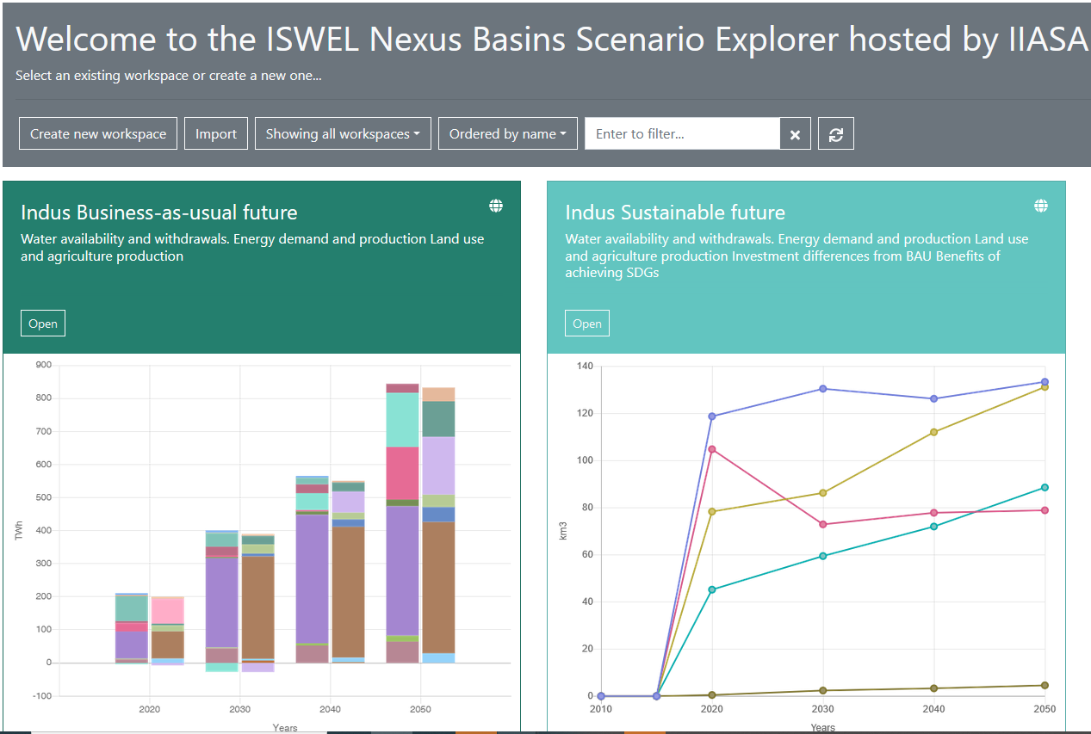
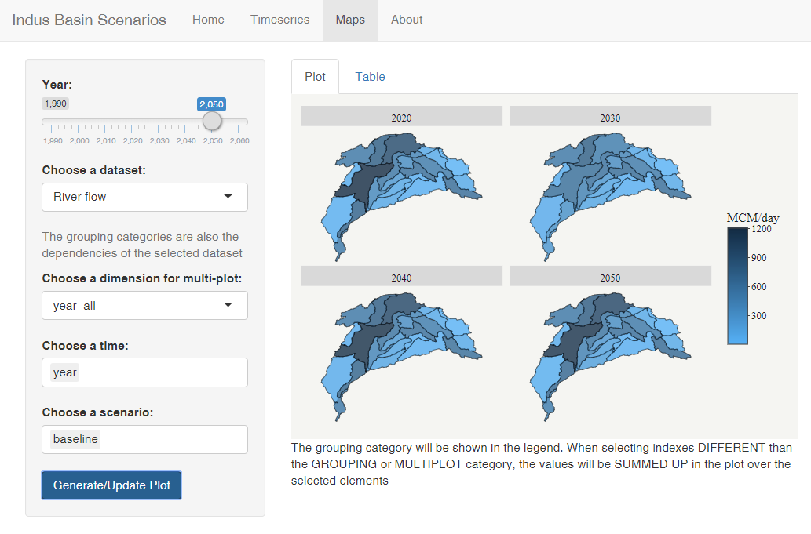
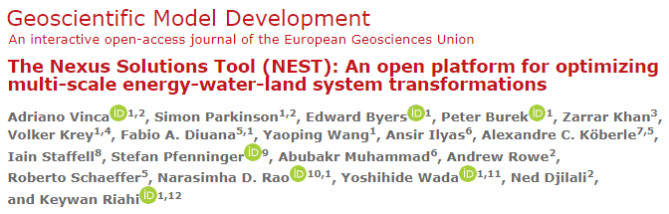
Open-source tool
CWaTM and MESSAGEix are open-source tools, accessible and well documented online (limitation on solvers)
NEST has it’s own documentation (Vinca et al., 2020, GMD) open Github repository, interactive scenario explorer
Limitations: Availability vs accessibility/ user friendly. Data
Different audience:
scientific: interest in data and model
policy makers: interested in interactive tools
https://github.com/iiasa/NEST
https://data.ene. iiasa.ac.at/nexus-basins/
http://vinca.shinyapps.io/indus_explorer

Slide 18
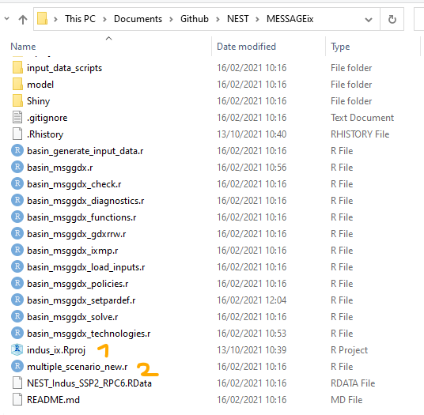
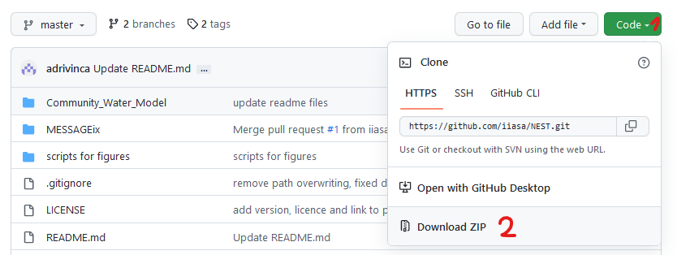
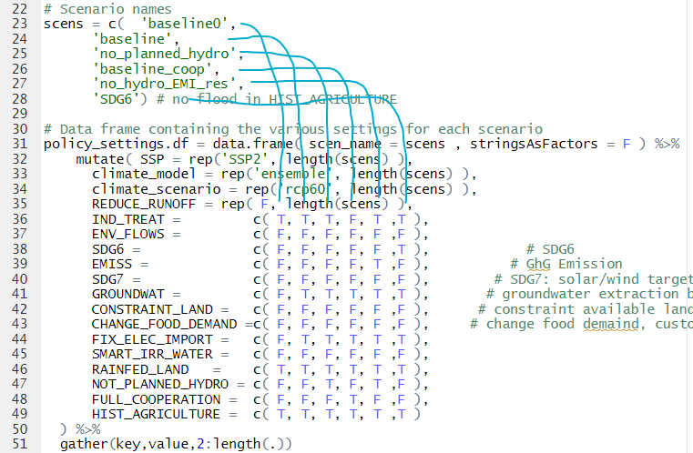
Access, download and run NEST
Prerequisites:
GAMS with active license, R, (Rstudio recommended), download and install the gdxrrw R package from here
Check paths: GAMS, R
Scenario names
Download (or clone with Github) the folder from : https://github.com/iiasa/NEST
Unzip the folder
Open the R project and multiple_scenario_new.r
Define path: INDUS_IX_PATH (and restart Rstudio), update GAMS path in basin_msggdx.r)
RUN
Policy options

Slide 19


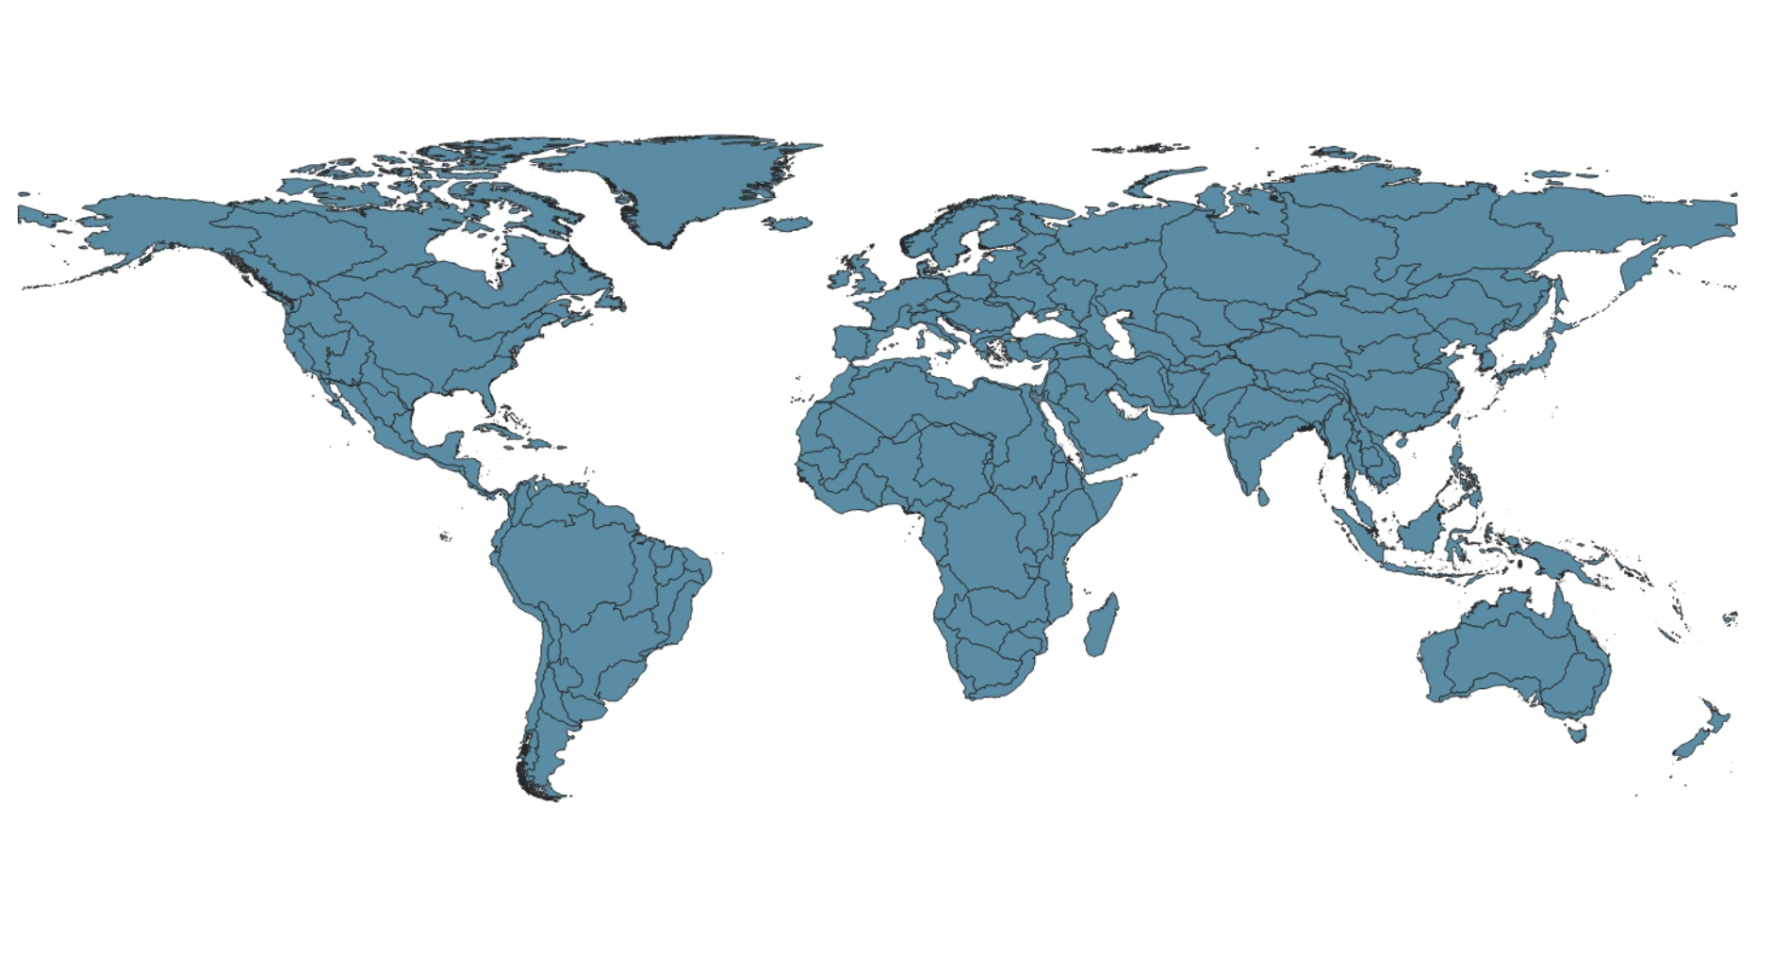
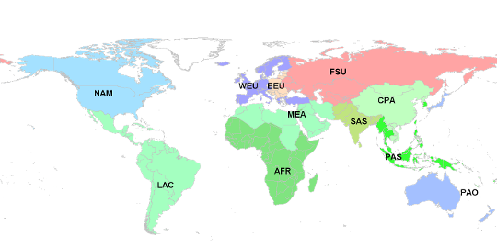

MESSAGEix-Nexus Module of the MESSAGEix-GLOBIOM family
Water System
Water availibility
Sectoral water demands
Supply & distribution
Water table depth
Land System
Irrigation water
Crop efficiency
Crop types
Biomass trajectories
Harmonization &
upscaling
GLOBIOM emulator
Water Sector
~202 regions/basins
Energy Sector
11 region
water <->energy, land sector
*ISIMIP Output data from Global Hydrological Models - https://www.isimip.org/
**GLOBIOM – Global Biospehere Management model - https://iiasa.github.io/GLOBIOM/
Notes:
We plan to implement water constraints suhc as availabel water, water sectoral demands on these 202 basins by using the harmonized outputs from the global hydorlogical model, CWATM. These constraints will be mapped to energy sector i.e 11 regions wherever there is need to access the implications of sectoral activities. We are also having discussion with the modelling team of GLOBIOM to provide us more information on irrigation water demand and use from the outputs from GLOBIOM to better access the water use for irrigation and its energy implications.

Slide 20


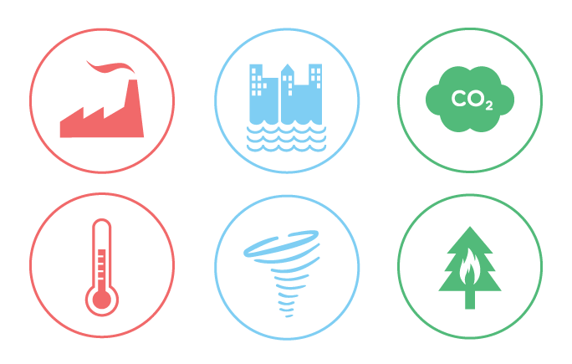




Approach: MESSAGEix-GLOBIOM IAM
Climate policy
SDG measures
Climate impacts
RCP 2.6, 6.0
Food Heathy (EAT-Lancet) diet, reduce food waste
Water Efficiency improvements, environmental flow
constraints, piped water access, wastewater
treatment
Energy Maximized electrification, phase-out traditional bio, cooling gap
Life on land Protected natural land (>30%)
Hydrology: Precipitation pattern/runoff, groundwater intensity
Crop Yield changes
Renewable energy
Cooling/heating demand
Desalination potential
Power plant cooling capacity
Based on: ISIMIP 2b (Frieler et al. 2017 ),Byers et al., 2018, Gernaat et al., 2021 etc.)
2.6 W/m² target
Based on: Doelman et al. 2022, MESSAGE-ACCESS, Van Vuuren et al., 2019, Parkinson et al., 2019, Frank et al., 2021, Hasegawa et al., 2015, Pastor et al., 2019

Slide 21
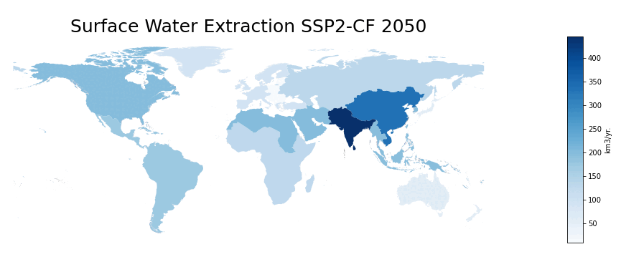
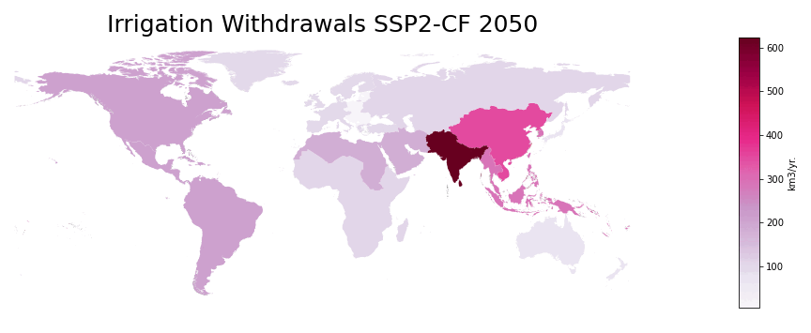
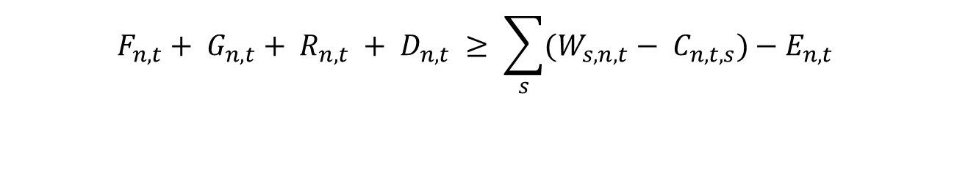
Water balance
$$F_{n,t}+ G_{n,t}+ R_{n,t} + D_{n,t} ≥ \sum_{s}{(W_{s,n,t}− C_{n,t,s})−E_{n,t}}$$
F - Freshwater supplied from river basins
G - Freshwater supplied from groundwater aquifers
R - freshwater supplied from wastewater recycling facilities W - Withdrawals from sectors (agriculture, municipal, energy, industrial)
C - Conservation measures
E - Environmental flows
s - sectors (agriculture, energy, industrial)
n - nodes (river basins)
t - time periods
Notes:
5 arc min

Slide 22
Approach – Climate Impacts
Climate impact | Approach | IMAGE | MESSAGEix-GLOBIOM
Renewable supply (wind, PV, CSP, hydro, bioenergy) | Different costs supply curves based on 0.5x0.5 grid calculations [Gernaat, et al. 2021] | Yes | Yes, hydropower only
Heating / cooling demand | Impact via population weighted HDD, CDD based on 0.5 x 0.5 grid [Byers, et al. 2018] | Yes | Yes
Water availability | Runoff and groundwater recharge from LPJmL calculated at 0.5 x 0.5 grid (ISIMIP 2b) [Frieler et al., 2017] | Yes | Yes
Crop yields | IMAGE: Crop yield change due to climate change calculated in LPJmL on 0.5 x 0.5 grid [Schaphoff et al., 2018 ] MESSAGE-GLOBIOM: Crop yields from [Byers et al., 2018] are used in the GLOBIOM model. | Yes | Yes
Power plant cooling & desalination potential | Power plant cooling: van Vliet 2016 Desalination: specific analysis | No | yes

Slide 23
Scenario | Climate Forcing (W/m²) | SDGs | Impacts
SSP2-noCF | 6.0 | No additional effort | Frozen to 2020
SSP2-CF | 6.0 | No additional effort
SSP2-SDG-noCF | 6.0 |  | Frozen to 2020
SSP2-SDG-CF | 6.0
SSP2-26-SDG-CF | 2.6
SSP2-26-CF | 2.6 | No additional effort
SSP2 – Middle of the Road Socio Economic Pathway
CF – Climate Feedback
Notes:
This section describes the nexus SDG measures as included in both the models in the SDG scenarios. Table 2 provides an overview of the measures and their representation in the models. I will briefly explain the The underlying methodology and approach In the following slides. Most measures are implemented in an equal or very similar way in both models, to allow for a fair comparison. An exception is the water SDG, where MESSAGEix-GLOBIOM includes measures on sanitation and wastewater and IMAGE has a stronger focus on water efficiency. The interaction between these measures and the other SDG categories is relatively limited.
Where relevant in the analyses, we have looked at single-model results in these cases.
Radiative forcing (or climate forcing^{[1]}) is the change in energy flux in the atmosphere caused by natural or anthropogenic factors of climate change as measured by watts / metre

Slide 24


Access MESSAGEix-Nexus (in progress)
code
documentation
MESSAGEix
https://github.com/iiasa/message_ix
MESSAGEix-GLOBIOM model
https://github.com/iiasa/message-ix-models/
https://docs.messageix.org/en/stable/
https://docs.messageix.org/projects/models/en/latest/

Slide 25
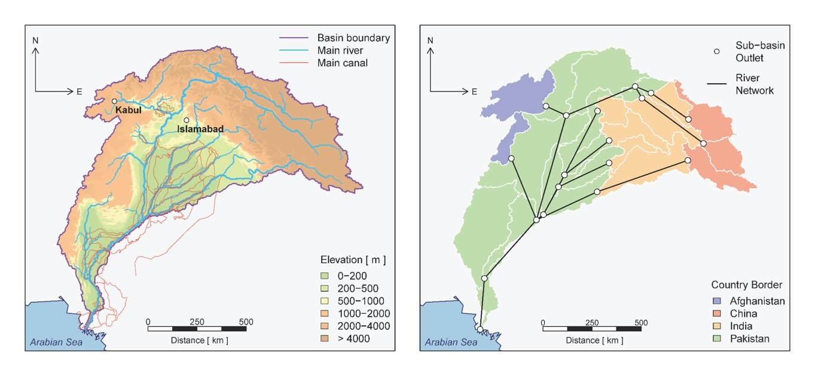
Upcoming work - Flexibility across scales
MESSAGEix (Global)
MESSAGEix-Country
Updated country scale model with water representation as in global model
Downscale/Prototype (existing method)
Add water-nexus to the country model
NEST Indus (Basin)
Improve existing model structure to be flexible to other regions in future
MESSAGEix-Nexus (National/Basin)
Bottom-up approach/sub-catchment level
Notes:
Another key objective of this exercise is to make the module flexible across different regions. Once we successfully implement the nexus module, we will be able to downscale the global model with water implementation using the existing country prototyping approach used within the program.

Slide 26
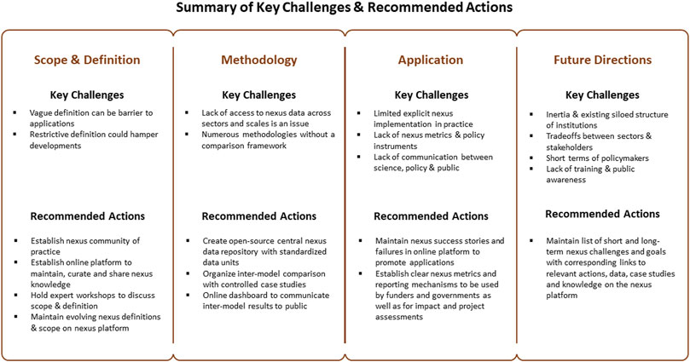
The way forward
Kahn et al., 2022, Frontiers in Environmental Science

Slide 27
Main conclusions
Integrated analysis gives more complete answers than single sector assessments
Difficult to compare/validate results: More multi-model intercomparison is needed; Need for more shared common assumptions in modelling community (like SSP, SDG for water and land)
Open-source, where to focus our efforts: code, data or interactive tools?
Scientists: data, well documented code/software
Policy makers: simplified interactive models, results visualization explorers

Slide 28
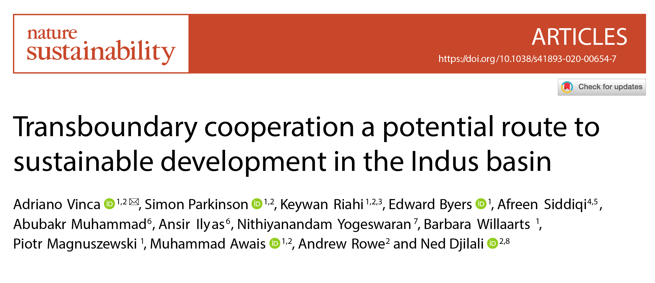
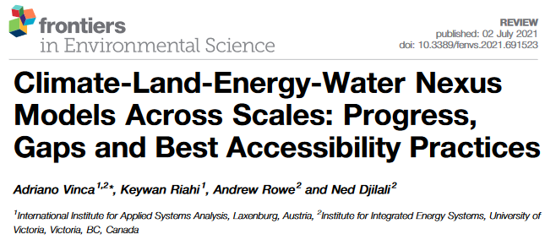
Thank you very much for your attention!
For more detail about the model, scenarios and results:
Adriano Vinca
(IIASA) vinca@iiasa.ac.at

Slide 29
Back up slides

Slide 30
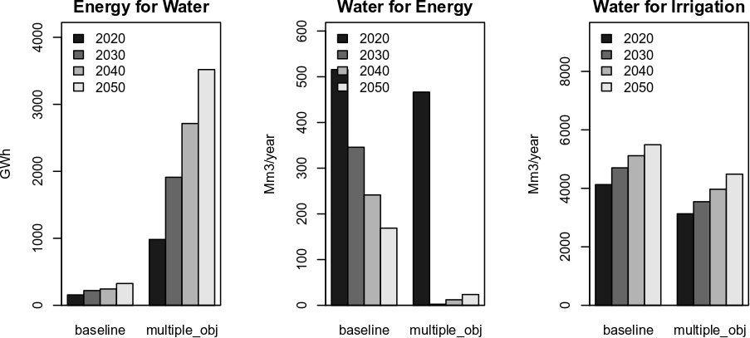
Multiple objective: cross-sectorial flows

Slide 31
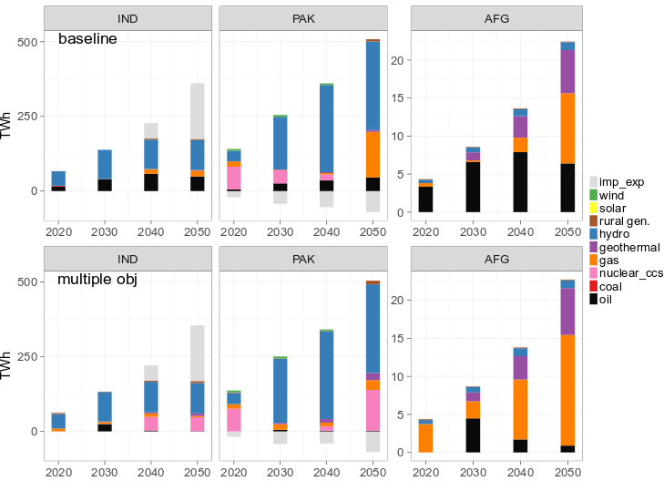
Multiple objective scenario: water use
Mostly nuclear replacing fossil fuel, cooling technologies with low water consumption (e.g. air cooling)

